Slide 1
TELECOM CUSTOMER
CHURN PREDICTION
CS-513 Knowledge Dis & Data Mining
Manas Kulkarni
Sai Goutham Gaddam
Yash Daftardar
Sujay Salvi

Slide 2




CS-513 Knowledge Dis & Data Mining
Sujay
Salvi
Sai
Goutham
Gaddam
Yash
Daftardar
Manas
Kulkarni

Slide 3
WHAT IS CUSTOMER CHURN?
CS-513 Knowledge Dis & Data Mining
Customer churn, also known as customer attrition, occurs when customers stop doing business with a company.
The companies are interested in identifying segments of these customers because the price for acquiring a new customer is usually higher than retaining the old one.

Slide 4
WHAT IS THE PROBLEM?
CS-513 Knowledge Dis & Data Mining
Customer churn is a major problem and one of the most important concerns for large companies
Due to the direct effect on the revenues of the companies, especially in the telecom field, companies are seeking to develop means to predict potential customer churn
Therefore, finding factors that increase customer churn is important so that necessary actions can be taken reduce this churn

Slide 5
HOW THE DATA IS?
CS-513 Knowledge Dis & Data Mining
The data consists of 100 variables and 100 thousand records.
It contains different variables explaining the attributes of telecom industry.
The target variable here is churn which explains whether the customer will churn(1) or not(0).
This data can be used to predict the customers who would churn or who would not churn.

Slide 6
HOW THE DATA CLEANING IS DONE?
CS-513 Knowledge Dis & Data Mining
The data consists of numeric attributes and non numeric attributes.
It contains many empty cells which are replaced by suitable values.
Non numeric variables are converted to numeric data i.e., they are categorized.
Empty cells in numeric data and non numeric data are filled accordingly.

Slide 7
HOW THE EMPTY CELLS ARE FILLED?
CS-513 Knowledge Dis & Data Mining
All the empty cells in the numeric data are filled by floor of mean of all the entries in a particular column
All the empty cells in the non numeric data are filled by mode of all the entries in a particular column after categorization
There are a few columns like CustomerID which has no empty cells and are left untouched.
The final data set after manipulation consists of only numeric data with no empty cells.

Slide 8
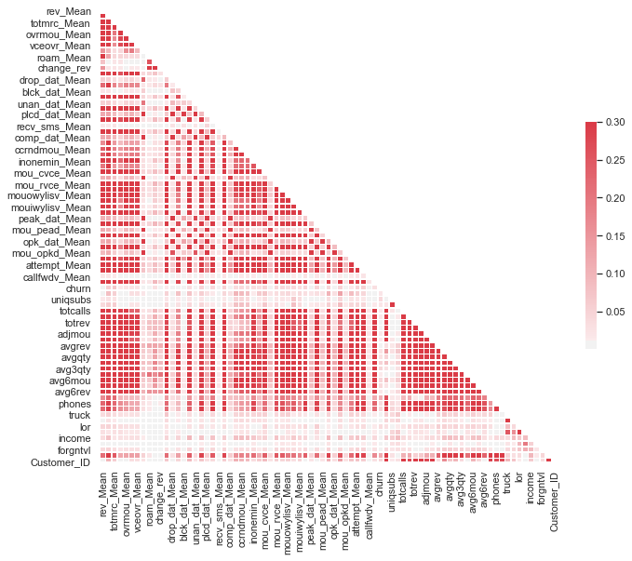
CORRELATION AMONG DIFFERENT VARIABLES
CS-513 Knowledge Dis & Data Mining
Initially we had 100 variables in our data
Remove variables which had correlation higher than 0.55
Using correlation matrix we reduced the variables to 24

Slide 9
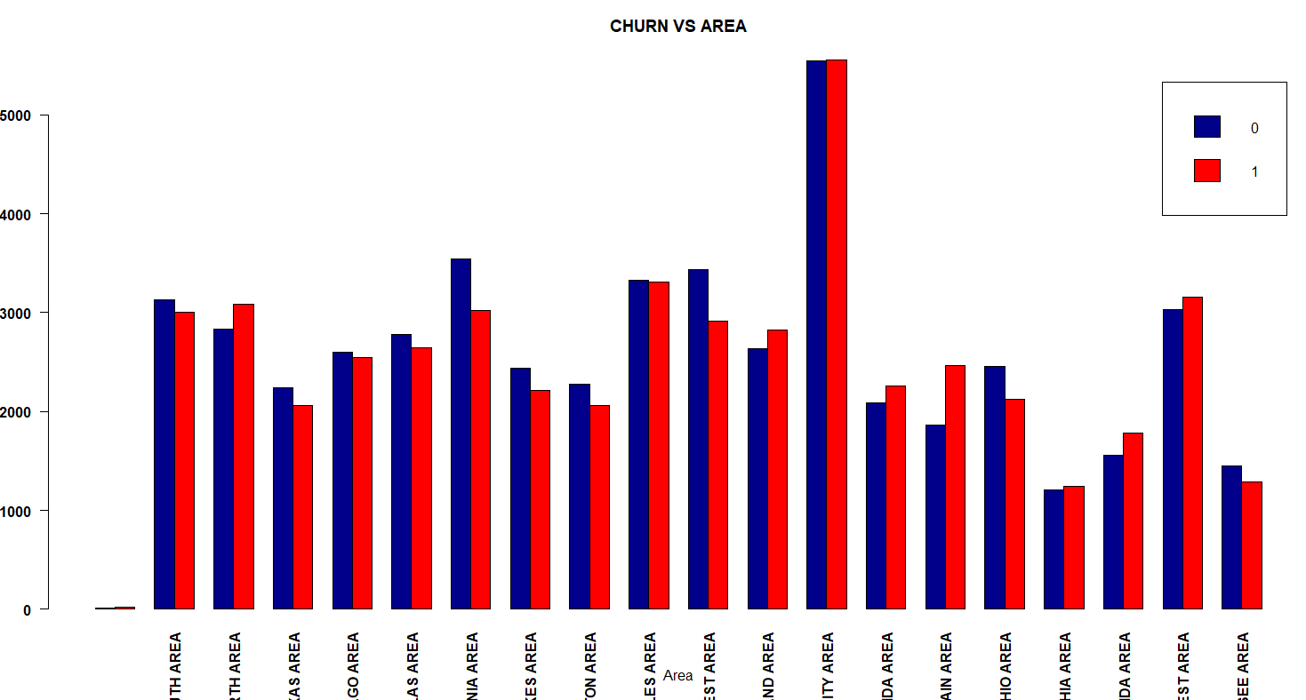
Exploratory Data Analysis
CS-513 Knowledge Dis & Data Mining

Slide 10
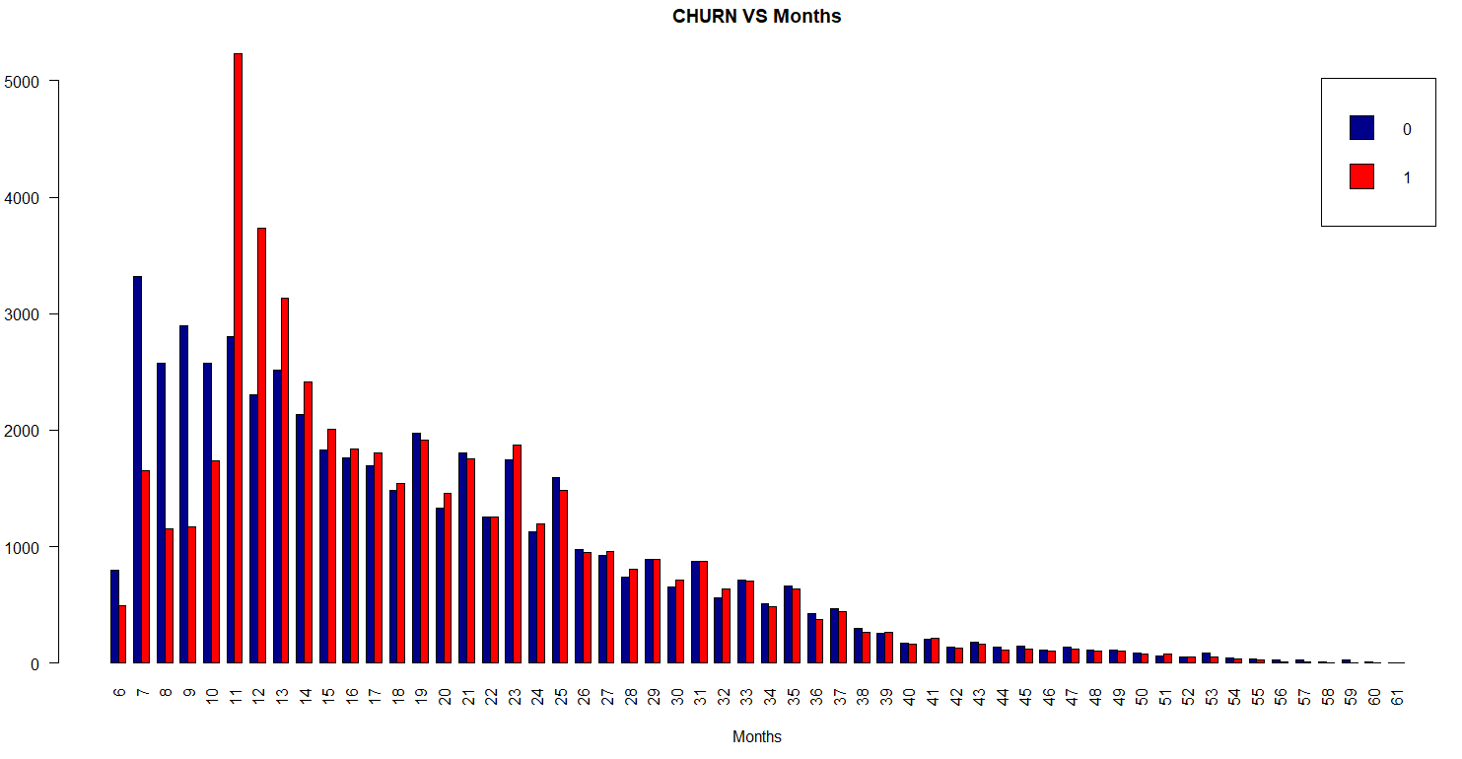
Exploratory Data Analysis
CS-513 Knowledge Dis & Data Mining

Slide 11
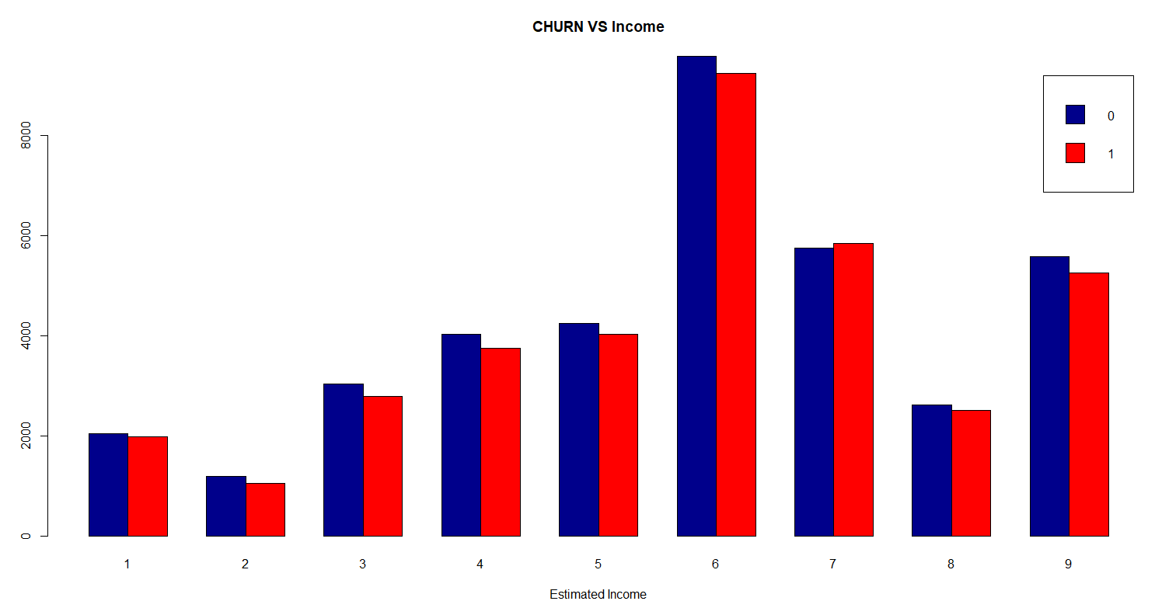
Exploratory Data Analysis
CS-513 Knowledge Dis & Data Mining

Slide 12
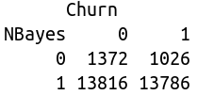
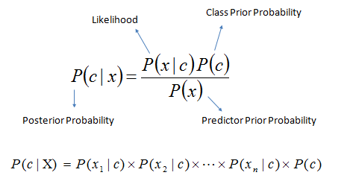
NAIVE BAYES
CS-513 Knowledge Dis & Data Mining
As the name suggests, this algorithm makes an assumption as all the variables in the dataset is “Naive” i.e not correlated to each other
Confusion Matrix :
Error Rate : 0.49
Notes:
Where,
P(c|x) is the posterior probability of class c given predictor ( features).
P(c) is the probability of class.
P(x|c) is the likelihood which is the probability of predictor given class.
P(x) is the prior probability of predictor.

Slide 13
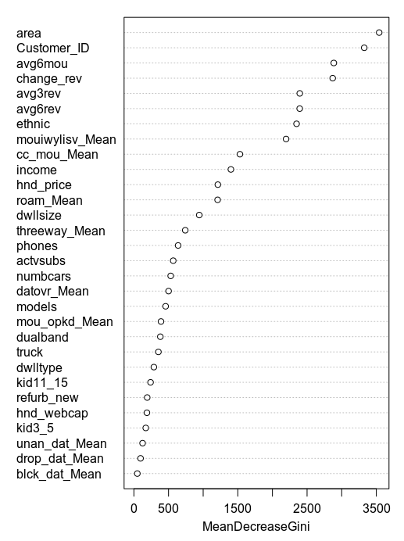
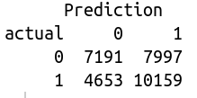
RANDOM FOREST
CS-513 Knowledge Dis & Data Mining
Each decision tree gives a vote for the prediction of target variable. Random forest choses the prediction that gets the most vote.
Error Rate : 0.42

Slide 14
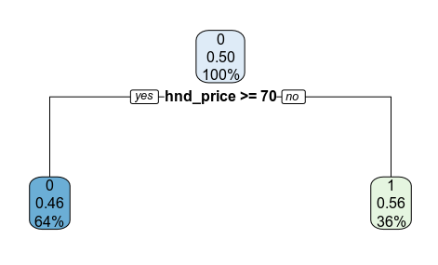
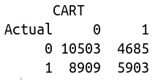
CLASSIFICATION & REGRESSION TREE (CART)
CS-513 Knowledge Dis & Data Mining
CART constructs the tree based on a numerical splitting criterion recursively applied to the data
Error Rate : 0.45

Slide 15
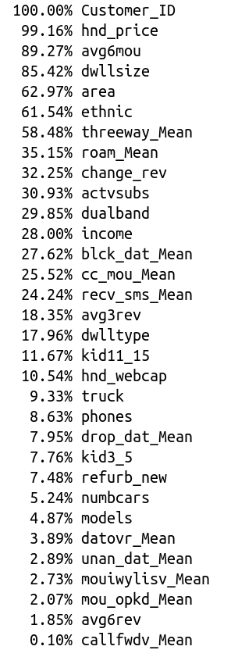
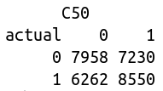
C 5.0
CS-513 Knowledge Dis & Data Mining
Memory efficiency
Smaller decision trees
Boosting (more accuracy)
Ability to weight different attributes
Error Rate : 0.44

